Slide 1
Your contoso benefits
A self-guided tour

Slide 2
highlights
Use Benefits Wisely
Take Advantage of Company Contributions
Make Use of your Benefits Counselors
Access Rich Online Information

Slide 3

Current trends

Slide 4






Project team
Nestor Wilke Director
Operations
Pradeep Gupta Accountant
Finance
Joni Sherman Paralegal
Legal
Debra Berger Administrative Asst
Executive Management
Emily Braun Budget Analyst
Finance
Lee Gu Director
Manufacturing

Slide 5
Project team
Nestor Wilke Director
Operations
Pradeep Gupta Accountant
Finance
Joni Sherman Paralegal
Legal
Debra Berger Administrative Asst
Executive Management
Emily Braun Budget Analyst
Finance
Lee Gu Director
Manufacturing

Slide 6
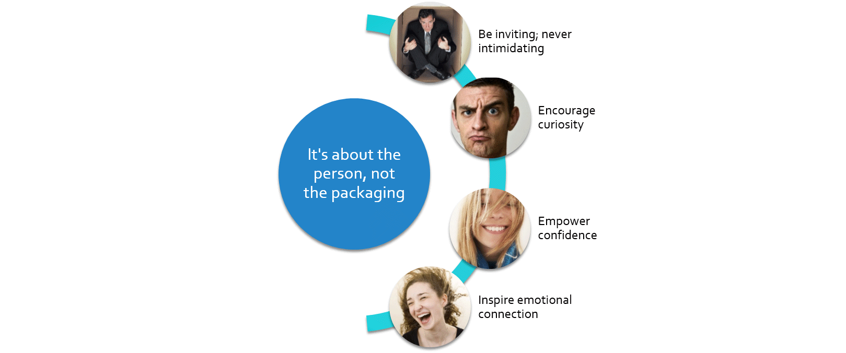
Fit the need—not the Box

Slide 7

Obtain buy-in through emotional connection
Emotional connection is key
The right connection inspires loyalty
It’s time to break new ground

Slide 8
Proposal design considerations
What Creates a Connection?

Slide 9

Making Choices
The key is to be selective and make effective choices
Every element must serve a purpose

